Slide 1

Automated WordPress Deployment Using Ansible
MUHAMMED REJAH E
MES24MCA-2033
Department of Computer Applications
MES College of Engineering, Kuttippuram
21-08-2025

Slide 2
PRODUCT OWNER Ms. FEBIN AZIZ ASSISTANT PROFESSOR DEPARTMENT OF COMPUTER APPLICATIONS MES COLLEGE OF ENGINEERING, KUTTIPPURAM

Slide 3
TABLE OF CONTENTS
Introduction
Objective
Existing System
Proposed System
Motivation
Functionalities
Module Description
Developing Environment
Sprint Backlog
Product Backlog
User Story
Project Plans
Data Flow Diagrams
ER Diagram

Slide 4
Automated WordPress Deployment Using Ansible
WordPress powers more than 40% of websites worldwide.
Deploying it manually requires multiple steps: installing packages,
configuring servers, databases, users, and SSL.
Manual deployment is slow and prone to human errors.
Ansible simplifies deployment using Infrastructure as Code (IaC).
Ensures speed, consistency, repeatability, and security.
Suitable for both on-premise servers and cloud platforms
(AWS, Azure, GCP).

Slide 5
OBJECTIVES
Automate WordPress website deployment using Ansible.
Automate WordPress website deployment using Ansible.
Configure secure SFTP and phpMyAdmin access.
Automate database creation and WordPress configuration.
Apply SSL certificates for HTTPS.
Demonstrate Infrastructure as Code (IaC) practices.

Slide 6
EXISTING SYSTEM
Traditional setup is manual:
Install packages (Nginx, MySQL, PHP) individually.
Configure servers and directories manually.
Errors occur due to misconfiguration.
Time-consuming and inconsistent results.

Slide 7
PROPOSED SYSTEM
Use Ansible to automate entire deployment.
Define steps in YAML playbooks.
Auto install Nginx, MySQL, PHP, phpMyAdmin.
Configure WordPress and database automatically.
Apply SSL for security.
System is scalable, reusable, and secure.

Slide 8
MOTIVATIONS
Growing importance of automation in DevOps & Cloud.
Manual deployment is inefficient for repeated setups.
Ansible is widely used in industry.
Helps students gain practical DevOps and Cloud skills.

Slide 9
FUNCTIONALITIES
Install and configure Nginx, PHP, MySQL.
Create Linux user & website directory.
Configure SFTP for secure file transfer.
Install phpMyAdmin for database management.
Download & configure WordPress automatically.
Create and manage MySQL database & users
Apply free SSL certificates (Certbot).

Slide 10
MODULE DESCRIPTION
Web Server Module – Installs and configures Nginx & PHP.
Database Module – Sets up MySQL and WordPress DB.
User Module – Creates Linux user and SFTP configuration.
phpMyAdmin Module – Sets up DB management tool.
WordPress Module – Deploys and configures WordPress.
Security Module – Adds SSL & permission settings.

Slide 11
DEVELOPING ENVIRONMENT
Operating System: Linux (Ubuntu / CentOS)
Automation Tool: Ansible (YAML Playbooks)
Web Server: Nginx
Backend: PHP 8+
Database: MySQL 10.6
CMS: WordPress
Admin Tool: phpMyAdmin
Security: SFTP, SSL (Certbot)
IDE: VS Code / Terminal

Slide 12
SPRINT BACKLOG
Backlog tem | Status And Completion Date | Original Estimation in Hours | Day 1 hrs | Day 2 hrs | Day 3 hrs | Day 4 hrs | Day 5 hrs | Day 6 hrs | Day 7 hrs | Day 8 hrs | Day 9 hrs | Day 10 hrs
SPRINT1
Install packages | 21/08/2025 | 3 | 1 | 1 | 1 | 0 | 0 | 0 | 0 | 0 | 0 | 0
configure Nginx & MySQL | 30/08/2025 | 4 | 1 | 1 | 1 | 1 | 0 | 0 | 0 | 0 | 0 | 0
SPRINT 2
Setup phpMyAdmin | 03/09/2025 | 7 | 1 | 1 | 1 | 1 | 1 | 1 | 1 | 0 | 0 | 0
SFTP | 12/09/2025 | 7 | 1 | 1 | 1 | 1 | 1 | 1 | 1 | 0 | 0 | 0

Slide 13
SPRINT BACKLOG
Backlog tem | Status And Completion Date | Original Estimation in Hours | Day 1 hrs | Day 2 hrs | Day 3 hrs | Day 4 hrs | Day 5 hrs | Day 6 hrs | Day 7 hrs | Day 8 hrs | Day 9 hrs | Day 10 hrs
SPRINT3
Deploy WordPress | 17/09/2025 | 7 | 1 | 1 | 1 | 1 | 1 | 1 | 1 | 0 | 0 | 0
configure DB | 27/09/2025 | 7 | 1 | 1 | 1 | 1 | 1 | 1 | 1 | 0 | 0 | 0
SPRINT 4
Add SSL | 01/10/2025 | 7 | 1 | 1 | 1 | 1 | 1 | 1 | 1 | 0 | 0 | 0
Testing & documentation | 09/10/2025 | 8 | 1 | 1 | 1 | 1 | 1 | 1 | 1 | 1 | 0 | 0
TOTAL |  | 50 | 8 | 8 | 8 | 7 | 6 | 6 | 6 | 1

Slide 14
PRODUCT BACKLOG
ID | NAME | PRIORITY | ESTIMATE (Hours) | STATUS
1 | Web Server Setup (Nginx + PHP) | High | 7 | PLANNED
2 | Database Setup (MySQL + User) | High | 7 | PLANNED
3 | WordPress Deployment | High | 7 | PLANNED
4 | phpMyAdmin Configuration | Medium | 7 | PLANNED

Slide 15
PRODUCT BACKLOG
ID | NAME | PRIORITY | ESTIMATE (Hours) | STATUS
5 | SFTP User & Directory Setup | High | 7 | PLANNED
6 | SSL Certificate (HTTPS) Setup | Medium | 7 | PLANNED
7 | Testing & Documentation | Medium | 8 | PLANNED

Slide 16
USER STORY
User Story ID | As a type of User | I want to | So that i can
1 | ADMIN | Deploy WordPress automatically | Save time and avoid manual errors in setup
2 | ADMIN | Manage phpMyAdmin | Easily access and manage MySQL databases
3 | USER | Access WordPress website securely (HTTPS) | Ensure my data and interactions are protected
4 | USER | Upload files via SFTP | Transfer files securely without exposing system risks

Slide 17
USER STORY
User Story ID | As a type of User | I want to | So that i can
5 | STUDENT | Learn Ansible playbooks and automation | Gain practical skills for DevOps and cloud environments
6 | DEVELOPER | Replicate deployment across multiple servers | Ensure consistency and scalability in hosting
7 | STUDENT | Experiment with Infrastructure as Code (IaC) | Understand real-world DevOps workflows and cloud readiness

Slide 18
PROJECT PLAN
User StoryID | Task Name | Start Date | End Date | Days | Status
1 | Sprint 1 | 21/08/2025 | 29/08/2025 | 10 | Planned
2 |  | 30/08/2025 | 01/09/2025 |  | Planned
3 | Sprint 2 | 03/09/2025 | 11/09/2025 | 14 | Planned
4 |  | 12/09/2025 | 16/09/2025 |  | Planned

Slide 19
PROJECT PLAN
User StoryID | Task Name | Start Date | End Date | Days | Status
5 | SPRINT 3 | 17/09/2025 | 26/09/2025 | 13 | Planned
6 |  | 27/09/2025 | 30/09/2025 |  | Planned
7 | SPRINT 4 | 01/10/2025 | 08/10/2025 | 09 | Planned
8 |  | 09/10/2025 | 09/10/2025 |  | Planned

Slide 20
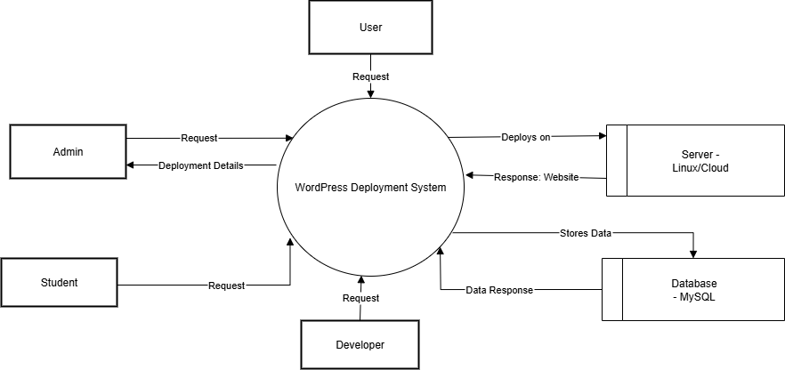
DATA FLOW DIAGRAM
LEVEL 0

Slide 21
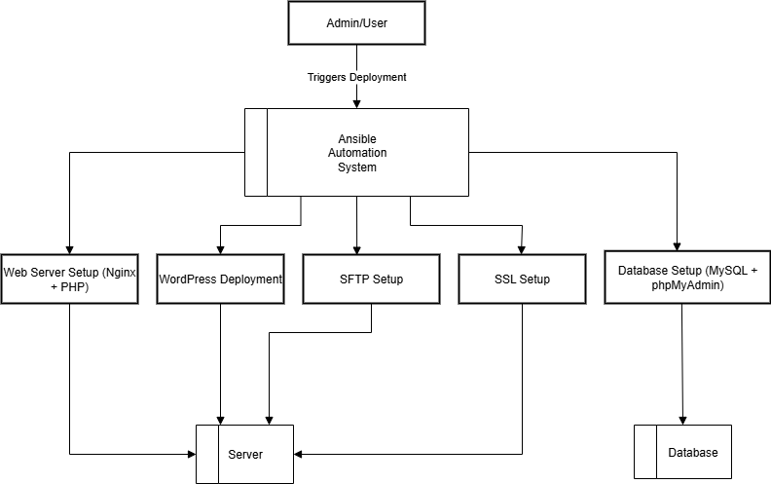
DATA FLOW DIAGRAM
Level 1.1

Slide 22
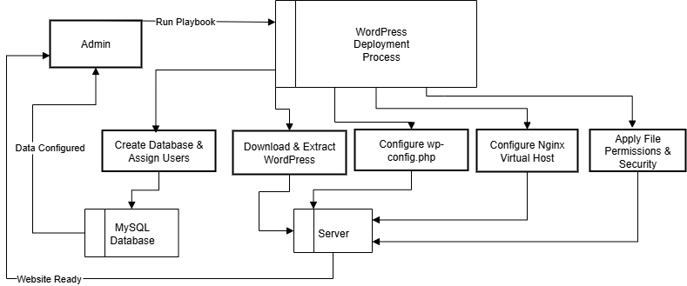
DATA FLOW DIAGRAM
Level 1.2

Slide 23
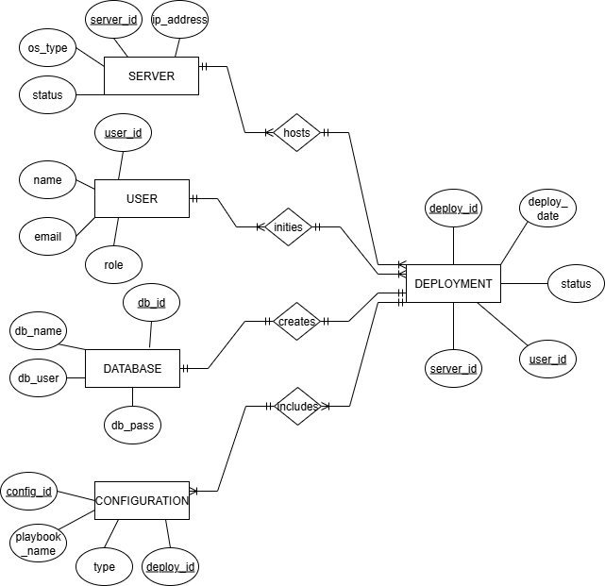
ER DIAGRAM

Slide 24
THANK YOU

